Slide 1
Full stack
Web development
Name : Hemant Singh
University roll no. 2300290100122
Cse 3_c 23-27 batch
Presentation for mlsa

Slide 2
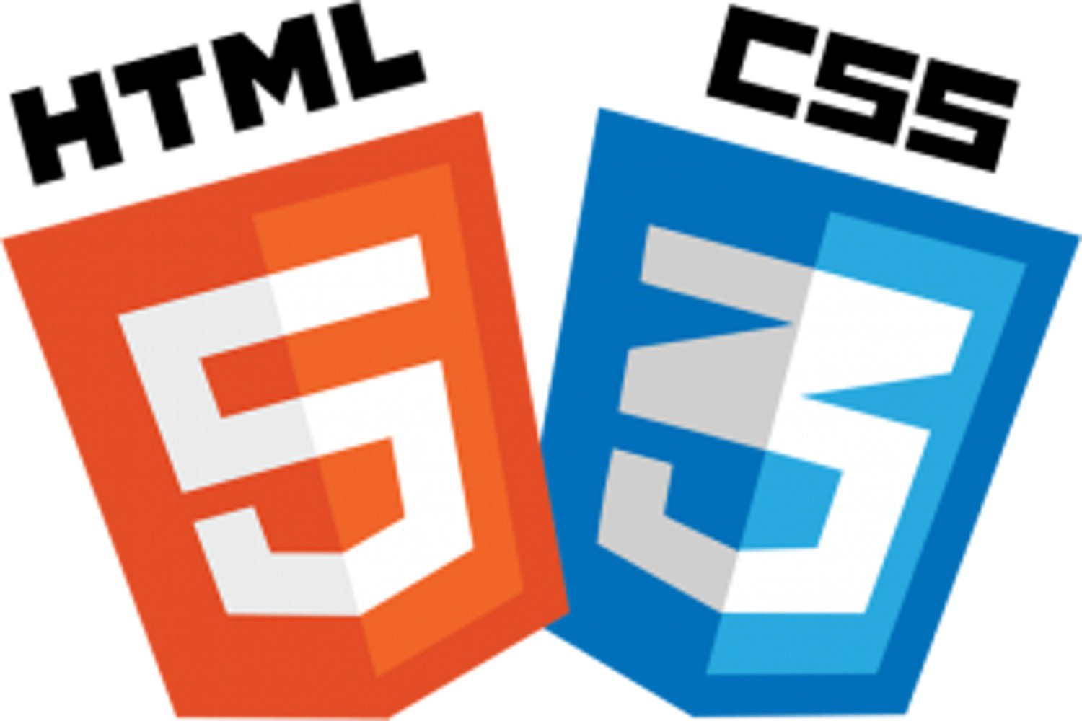


The goats of frontend web :
This Photo by Unknown Author is licensed under CC BY-NC
This Photo by Unknown Author is licensed under CC BY-SA
This Photo by Unknown Author is licensed under CC BY-NC
HTML structures online content, while CSS styles it—together they create visually engaging and organized web pages.
JavaScript adds interactivity to websites, enabling dynamic content, animations, and user-driven actions for an engaging experience.
React is a JavaScript library for building dynamic, fast, and interactive user interfaces in web applications.

Slide 3
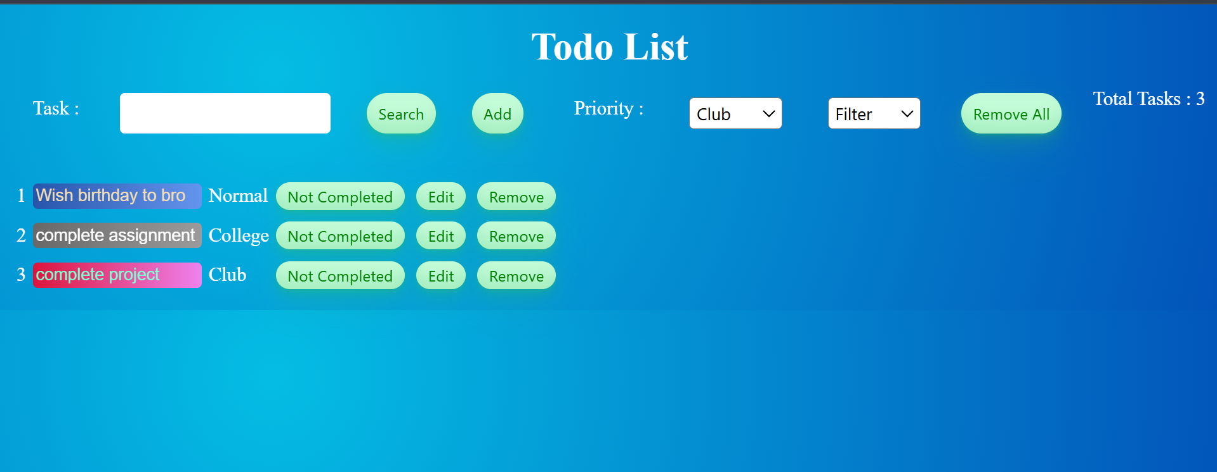
React app : to do list

Slide 4

React application to-do list
🌟 Excited to share my recent project in React! Today, I built a To-Do List application, adding some cool features to enhance functionality and user experience: 👉 Priority-Based Tasks: You can now assign priority levels to each task. 👉 Priority Filter: Easily filter tasks by their priority level for quick access. 👉 Custom Backgrounds: Different backgrounds for each priority level make tasks more distinguishable. 👉 Task Counter: Keep track of the total number of tasks at a glance. 👉 Task Management: Edit, remove individual tasks, or clear all tasks in a single click. 👉 Search Functionality: Quickly find tasks using the search option. Loving the journey of learning React and bringing ideas to life! 🚀
This Photo by Unknown Author is licensed under CC BY-SA

Slide 5
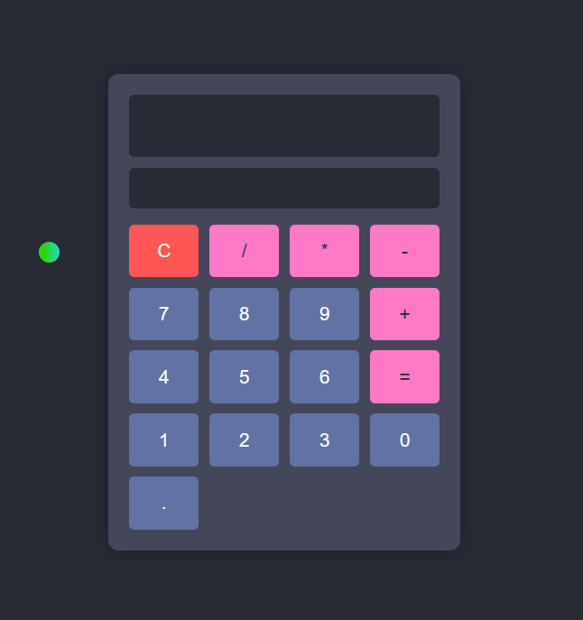
Vanilla JavaScript : calculator

Slide 6

Vanilla JavaScript : calculator
🌟 Excited to share my recent project! I built a simple Calculator using HTML, CSS, and Vanilla JavaScript, styled with the Dracula theme. This project helped me dive deeper into core web development concepts and UI design. Loving the journey of learning and bringing ideas to life! 🚀

